Slide 1
GeekOS Project 0 Kernel thread and key

Slide 2
Project 0
Purpose
get you familiar with the development environment and simulator
Assignment
write a simple kernel mode thread that prints a message
prompts for keyboard input until the exit command is entered

Slide 3
Assignment
Add a kernel thread
See the functions in kthread.c
You need to use Start_Kernel_Thread
You need to implement thread function.
Kernel thread function
Print out “Hello from xxx” (xxx is your student ID).
Call the function Wait_For_Key (keyboard.c)
echo each character entered
Repeat until Ctrl-D is entered.

Slide 4
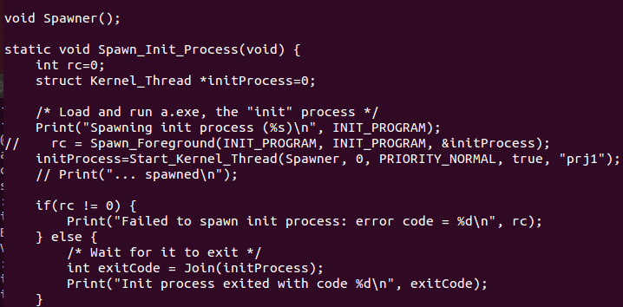
실습
이 부분 변경
Spawner를
다른 함수로 구현

Slide 5
Skeleton
static void my_func() {
int id = /* yours */;
Keycode key=0;
while(/* key is not Ctrl-D */) {
Print(“Hello from %d : ”, id);
key=Wait_For_Key();
// Print key
}
}

Slide 6
점수
없음
단, 온라인 강의는 출석 확인용으로 사용
프로젝트 수행 전에 스스로 익숙해 질 수 있는 기회

